Slide 1
Topics in AI – Applied Natural Language Processing
8. Information Extraction

Slide 2
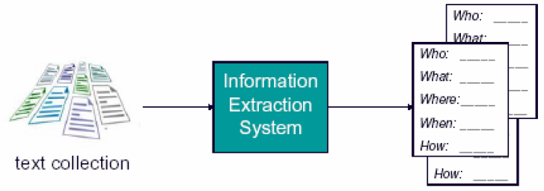
Information Extraction (IE)
Identify specific pieces of information (data) in an unstructured or semi-structured text
Transform unstructured information in a corpus of texts or web pages into a structured database (or templates)
Applied to various types of text, e.g.
  Newspaper
  articles
  Scientific
  articles
  Web pages
  etc.
Source: J. Choi, CSE842, MSU

Slide 3
Bridgestone Sports Co. said Friday it had set up a joint venture in Taiwan with a local concern and a Japanese trading house to produce golf clubs to be supplied to Japan.
The joint venture, Bridgestone Sports Taiwan Co., capitalized at 20 million new Taiwan dollars, will start production in January 1990 with production of 20,000 iron and “metal wood” clubs a month.
template filling
TIE-UP-1
Relationship: TIE-UP
Entities: “Bridgestone Sport Co.”
“a local concern”
“a Japanese trading house”
Joint Venture Company:
“Bridgestone Sports Taiwan Co.”
Activity: ACTIVITY-1
Amount: NT$200000000
ACTIVITY-1
Activity: PRODUCTION
Company:
“Bridgestone Sports Taiwan Co.”
Product:
“iron and ‘metal wood’ clubs”
Start Date:
DURING: January 1990

Slide 4
Why Information Extraction (IE)?
Science
  Grand old dream of AI: Build large knowledge base (KB) and reason with it. IE enables the automatic creation of this KB.
  IE is a complex problem that inspires new advances in machine learning.
Profit
  Many companies interested in leveraging data currently “locked in unstructured text on the Web”.
  Not yet a monopolistic winner in this space.
Fun!
  Build tools that we researchers like to use ourselves: Cora & CiteSeer, MRQE.com, FAQFinder,…
  See our work get used by the general public.
Source: Andrew McCallum, UMass Amherst

Slide 5
A Typical IE Processing Pipeline
Named Entity Recognition (NER) &
Shallow Parsing
Reference Resolution
Relation Detection & Classification
Event Detection & Classification
Template Filling

Slide 6

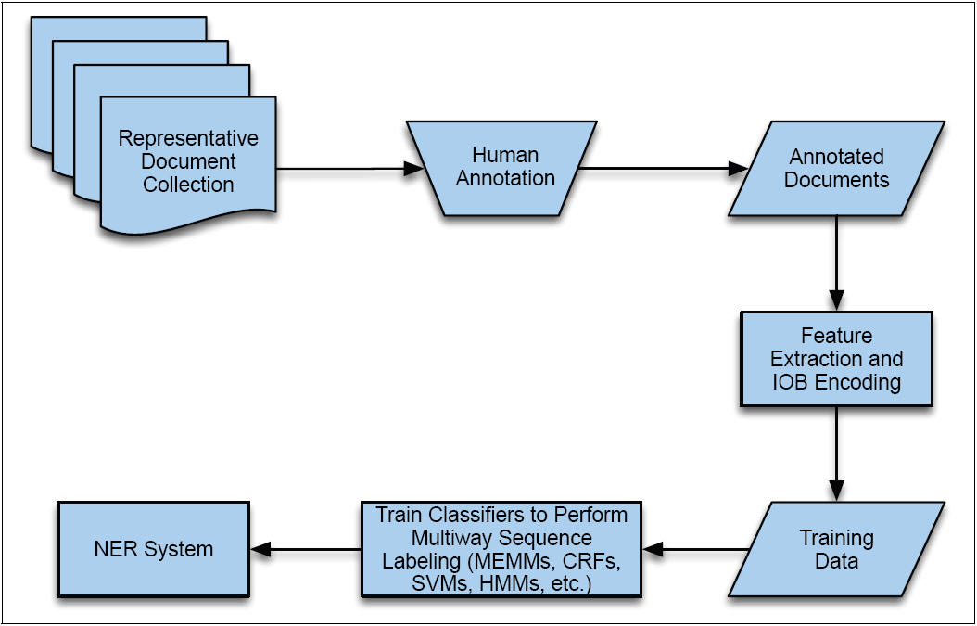
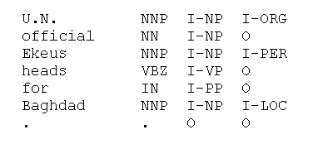
1. Named Entity Recognition
IOB notation
IE by statistical sequence labeling approach
Word POS Chunk EntityType

Slide 7
1. Named Entity Recognition (cont.)
After NEs are identified, dependency parsing is often applied to extract the syntactic/dependency relations between the NEs.
[_{PER} Bill Gates] founded [_{ORG} Microsoft].
found
Dependency Relations
nsubj(Bill Gates, found)
dobj(found, Microsoft)
nsubj
dobj
Bill Gates
Microsoft

Slide 8
2. Reference Resolution
Two types of references:
  Anaphora resolution
    Identify what a pronoun refers to (an entity that appeared earlier in the text) – “he”, “she”, “it”, “they”
  Co-reference resolution
    Identify what a noun (or noun phrase) refers to
Reference resolution is an important step in IE and a very difficult problem in NLP. However, we don’t cover it in this class.
Queen Elizabeth set about transforming her husband,
King George VI, into a viable monarch. Logue,
a renowned speech therapist, was summoned to help
the King overcome his speech impediment...

Slide 9
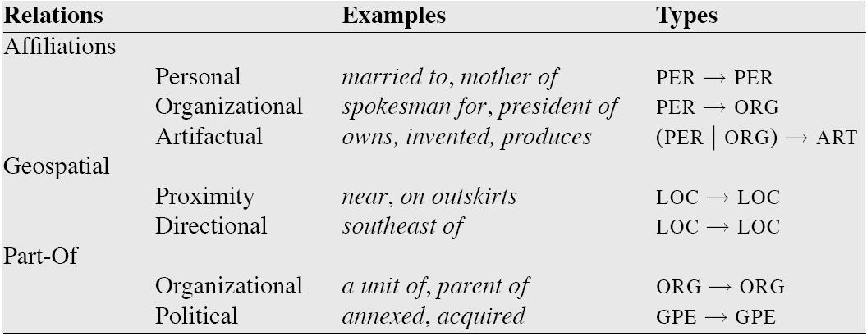
3. Relation Detection
Identify the semantic relations between named entities (or domain elements)
Relations include:
  General relations such as “part-of” and “employs”
  Domain-specific relations
Semantic relations with examples and the NE types they involve
Source: Jurafsky & Martin “Speech and Language Processing”

Slide 10
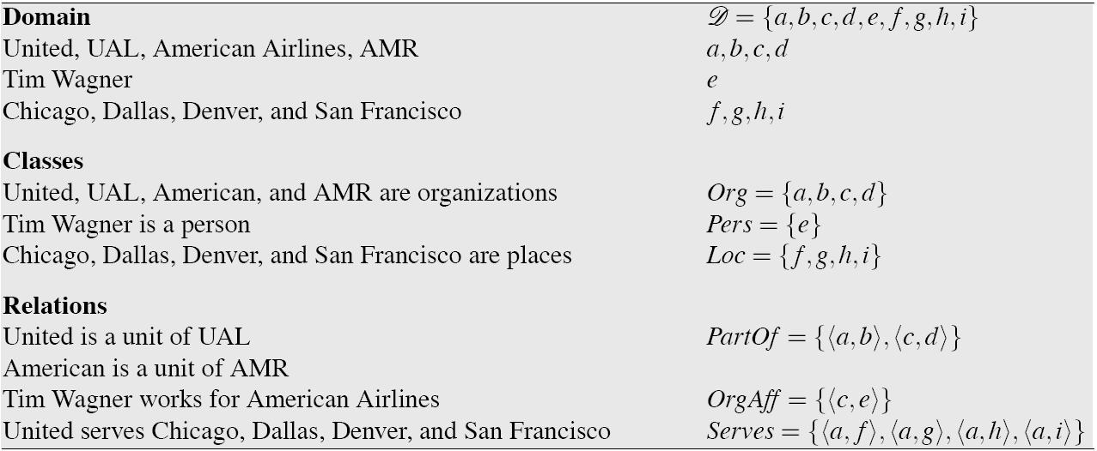
3.1 Supervised Learning for
Relation Analysis
Training data:
  Use a corpus annotated with NEs and relations
  An instance indicates two arguments, their roles, and the type of the relation involved
Source: Jurafsky & Martin “Speech and Language Processing”

Slide 11
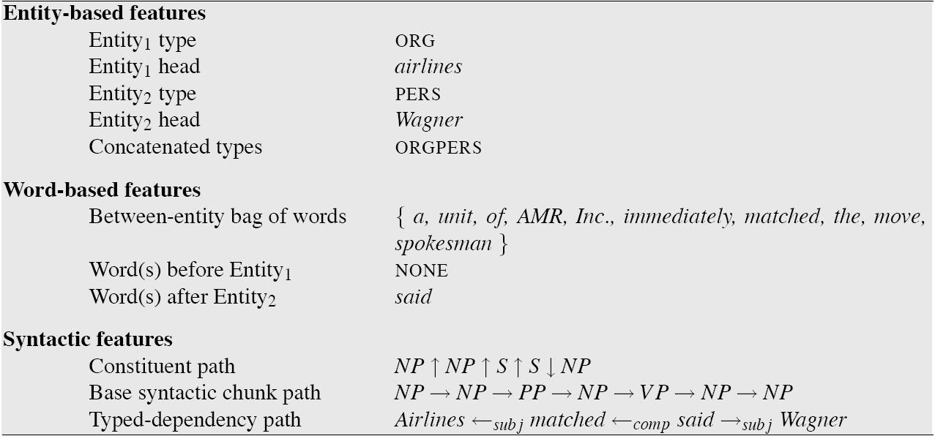
Supervised Learning for
Relation Analysis (cont.)
Typical approach:
  Step 1: Detect if a relation exists between two entities
  Step 2: If so, classify/label the relation
Features to represent an instance:
Source: Jurafsky & Martin “Speech and Language Processing”

Slide 12
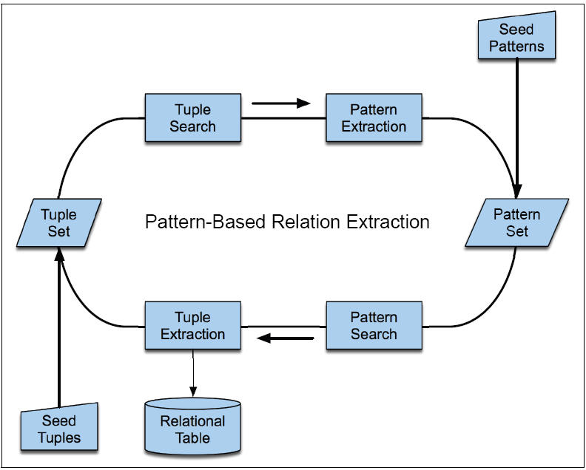
3.2 Pattern-based Relation Analysis
When an annotated corpus is not available, lightly-supervised methods can be used
  Step 1: Define a set of seed patterns as regular expressions,
  and extract all tuples that match the patterns
  Step 2: Bootstrap to find new patterns

Slide 13
4. Event Detection
Identify events or states mentioned for named entities (or domain elements)
In English, events correspond to verbs, plus some noun phrases (e.g. “the increase”, “the destruction”)
  But some difficult cases, e.g.
    Not all verbs denote an event (e.g. “took effect”)
    ‘Light verbs’ such as “make”, “take” are too generic.
    Must also look at its direct object/noun (e.g. “took a flight”)
    Of course, always the problem of (meaning) ambiguity…
[_{event} Citing] high fuel prices, United Airlines [_{event} said] Friday it has [_{event} increased] fares by $6 per round trip on flights to some cities also served by lower-cost carriers.
Source: Jurafsky & Martin “Speech and Language Processing”

Slide 14
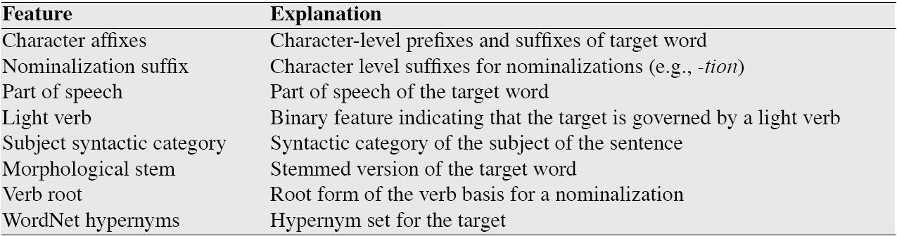
Event Detection (cont.)
Both rule-based and statistical ML approaches have been used for event detection
Features to represent an event instance:
Source: Jurafsky & Martin “Speech and Language Processing”

Slide 15
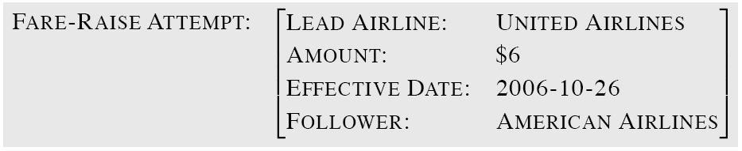
5. Template Filling
A template is a frame (of a record structure), consisting of slots and fillers. A template denotes an event or a semantic concept.
After extracting NEs, relations and events, IE fills an appropriate template
Two common approaches for template filling:
  Statistical approach
  Finite-state cascade approach
Source: Jurafsky & Martin “Speech and Language Processing”

Slide 16
5.1 Statistical Approach to
Template Filling
Again, by using a sequence labeling method:
  Label sequences of tokens as potential fillers for a particular slot
  Train separate sequence classifiers for each slot
  Slots are filled with the text segments identified by each slot’s corresponding classifier
  Resolve multiple labels assigned to the same/overlapping text segment by adding weights (heuristic confidence) to the slots
  State-of-the-art performance – F1-measure of 75 to 98
However, those methods are shown to be effective only for small, homogenous data.
Source: Jurafsky & Martin “Speech and Language Processing”

Slide 17
5.2 Finite-State Template-Filling Systems
Message Understanding Conferences (MUC) – the genesis of IE
  DARPA funded significant efforts in IE in the early to mid 1990’s.
  MUC was an annual event/competition where results were presented.
  Focused on extracting information from news articles:
    Terrorist events (MUC-4, 1992)
    Industrial joint ventures (MUC-5, 1993)
    Company management changes
  Information extraction of particular interest to the intelligence community (CIA, NSA). (Note: early ’90’s)
Source: Marti Hearst, i256, at UC Berkeley

Slide 18
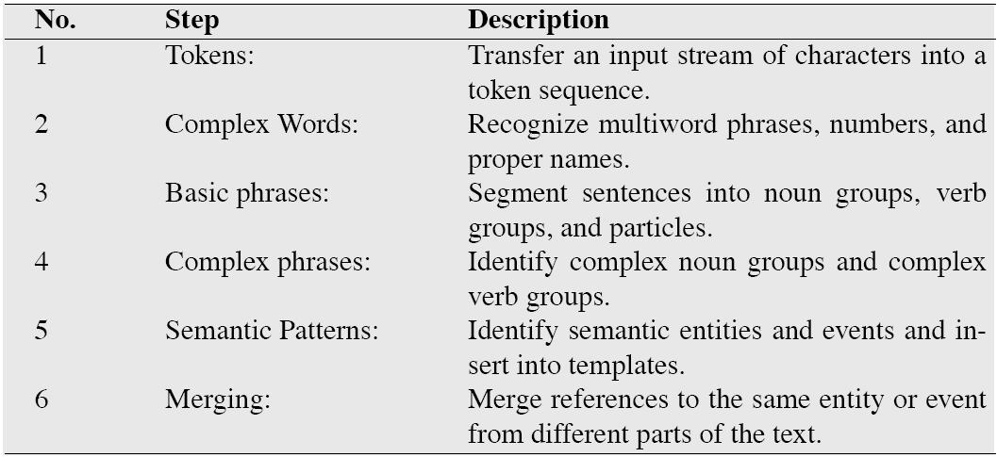
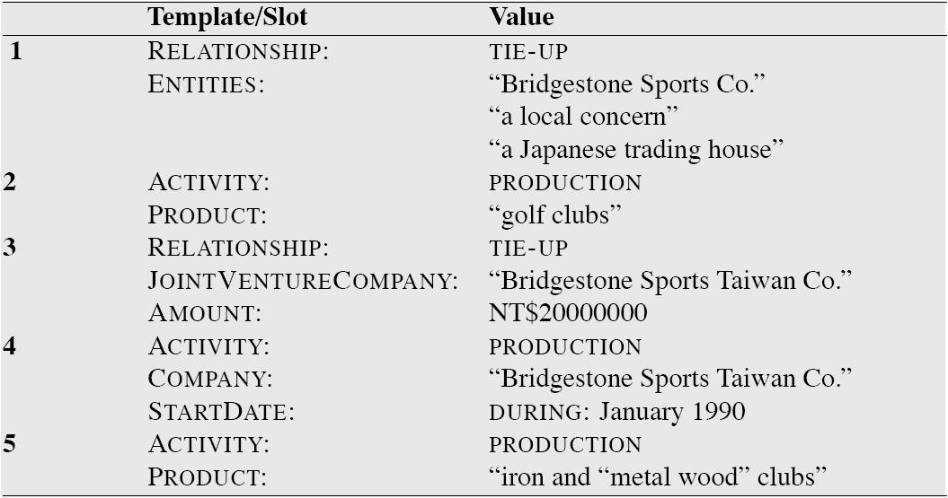
Finite-State Template-Filling Systems (cont.)
FASTUS system in MUC-5
  A cascade of transducers, where each level is a finite-state automata which extracts a specific type of information
  The task was to fill hierarchically linked templates
Source: Marti Hearst, i256, at UC Berkeley

Slide 19
Example of IE from FASTUS (1993)
Bridgestone Sports Co. said Friday it had set up a joint venture in Taiwan with a local concern and a Japanese trading house to produce golf clubs to be supplied to Japan.
The joint venture, Bridgestone Sports Taiwan Co., capitalized at 20 million new Taiwan dollars, will start production in January 1990 with production of 20,000 iron and “metal wood” clubs a month.
TIE-UP-1
Relationship: TIE-UP
Entities: “Bridgestone Sport Co.”
“a local concern”
“a Japanese trading house”
Joint Venture Company:
“Bridgestone Sports Taiwan Co.”
Activity: ACTIVITY-1
Amount: NT$200000000
ACTIVITY-1
Activity: PRODUCTION
Company:
“Bridgestone Sports Taiwan Co.”
Product:
“iron and ‘metal wood’ clubs”
Start Date:
DURING: January 1990
Source: Marti Hearst, i256, at UC Berkeley

Slide 20
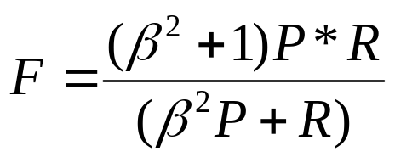
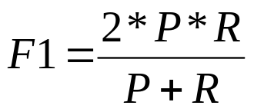
Evaluating IE Accuracy
Precision and Recall:
  Precision: correct answers / answers produced
  Recall: correct answers / total possible correct answers
F-measure:
  where β is a parameter representing relative importance of P and R.
  When P and R are equally important, β = 1 and we get the
  F1 measure:
Source: J. Choi, CSE842, MSU

Slide 21
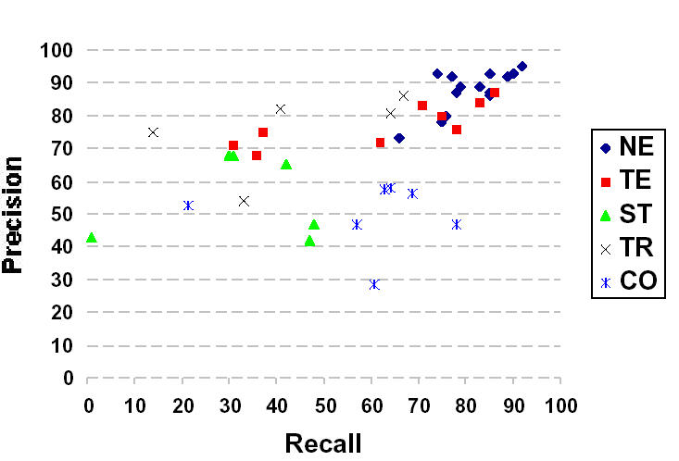
MUC Information Extraction:
State of the Art c. 1997
NE – named entity recognition
CO – co-reference resolution
TE – template element construction
TR – template relation construction
ST – scenario template production
Source: Marti Hearst, i256, at UC Berkeley

Slide 22
Successors to MUC
CoNLL: Conference on Computational Natural Language Learning
  Different topics each year
  2002, 2003: Language-independent NER
  2004: Semantic Role recognition
  2001: Identify clauses in text
  2000: Chunking boundaries
    http://cnts.uia.ac.be/conll2003/ (also conll2004, conll2002…)
    Sponsored by SIGNLL, the Special Interest Group on Natural Language Learning of the Association for Computational Linguistics.
ACE: Automated Content Extraction
  Entity Detection and Tracking
    Sponsored by NIST
    http://wave.ldc.upenn.edu/Projects/ACE/
Several others recently
  See http://cnts.uia.ac.be/conll2003/ner/
Source: Marti Hearst, i256, at UC Berkeley

Slide 23
State of the Art Performance: examples
Named entity recognition from newswire text
  Person, Location, Organization, …
  F1 in high 80’s or low- to mid-90’s
Binary relation extraction
  Contained-in (Location1, Location2)
  Member-of (Person1, Organization1)
  F1 in 60’s or 70’s or 80’s
Web site structure recognition
  Extremely accurate performance obtainable
  Human effort (~10min?) required on each site
Source: Marti Hearst, i256, at UC Berkeley

Slide 24
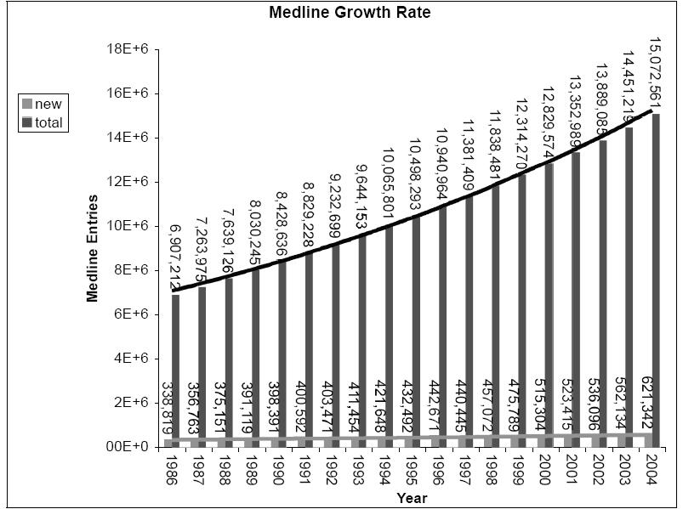
Advanced Topic:
Biomedical Information Extraction
IE from biomedical journal articles has become an important application area lately – due to a rapid growth in the number of publications in the field.
Source: Jurafsky & Martin “Speech and Language Processing”

Slide 25
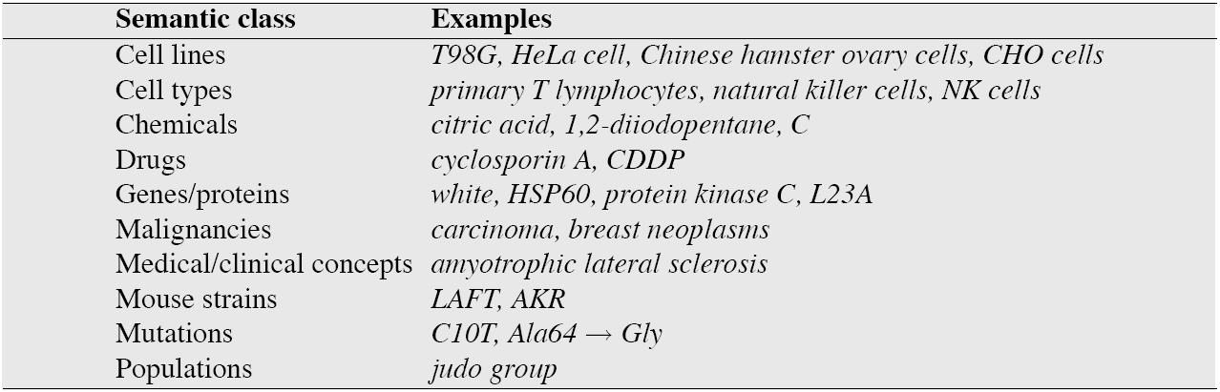
Biological NER
There are a much wider range of entity types (semantic classes) in the biological domain
[_{tissue} Plasma] [_{GP} BNP] concentrations were higher in both the [_{population} judo] and [_{population} marathon groups] than in [_{population} controls], and positively correlated with [_{ANAT} LV] mass as well as with deceleration time.
Source: Jurafsky & Martin “Speech and Language Processing”

Slide 26
Biological NER (cont.)
NER in this domain is particularly difficult because of the various forms which the names can take:
  e.g. “insulin”, “ether a go-go”, “breast cancer associated 1”
  Long names (thus multi-token boundary detection is needed)
  Spelling/typographical variations
  Abbreviations, symbols
  (Of course) Ambiguity (common meaning or domain concepts)
Extracted NEs are often mapped to biomedical ontologies (e.g. Gene Ontology, UMLS)
Source: Jurafsky & Martin “Speech and Language Processing”

Slide 27
Biological Roles and Relations
Two approaches:
  Discover and classify binary relations between NEs
  Identify and classify the roles played by NEs w.r.t. the event --- which constituents for which semantic roles
These results suggest that con A-induced [_{disease} hepatitis] was ameliorated by pretreatment with [_{treatment} TJ-135]. ➔ ‘curing’ relation
[_{disease} Malignant mesodermal mixed tumor of the uterus] following [_{treatment} irradiation] ➔ ‘result’ relation
[_{theme} Full-length cPLA2] was [_{target} phosphorylated] stoichiometrically by [_{agent} p43 mitrogen-activated protein (MAP) kinase] into vitro … and the major site of phosphorylation was identified by amino acid sequencing as [_{site} Ser505].
Note: the event for this sentence is ‘PHOSPHORYLATION’
Source: Jurafsky & Martin “Speech and Language Processing”

Slide 28
Automatic Role Labeling for
Biological Domain
Both rule-based and statistical approaches have been applied
Medical ontologies (in particular the link/inference structures) are often utilized
General results: The choice of algorithm is less important than the choice of features
Note: NER methods utilize syntactic features -- but no large treebanks are available for biomedical domain
➔ Off-the-shelf NER tools (trained with generic newswire exts) are often used.
Source: Jurafsky & Martin “Speech and Language Processing”

Slide 29
IE Techniques: Summary
Machine learning approaches are doing well, even without comprehensive word lists
  Can develop a pretty good starting list with a bit of web page scraping
  Lately Conditional Random Fields (CRFs) have shown superb performance over other sequence-labeling ML techniques
Features mainly have to do with the preceding and following tags, as well as syntax and orthographic features of words
  The latter is somewhat language dependent
With enough training data, results are getting pretty decent on well-defined entities
ML is the way of the future!
Source: Marti Hearst, i256, at UC Berkeley

Slide 30
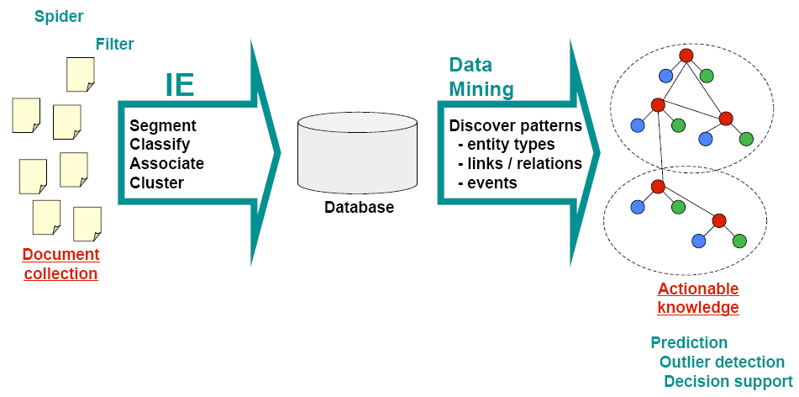
Extra:
From Text to Actionable Knowledge
Source: Andrew McCallum, UMass Amherst

Slide 31
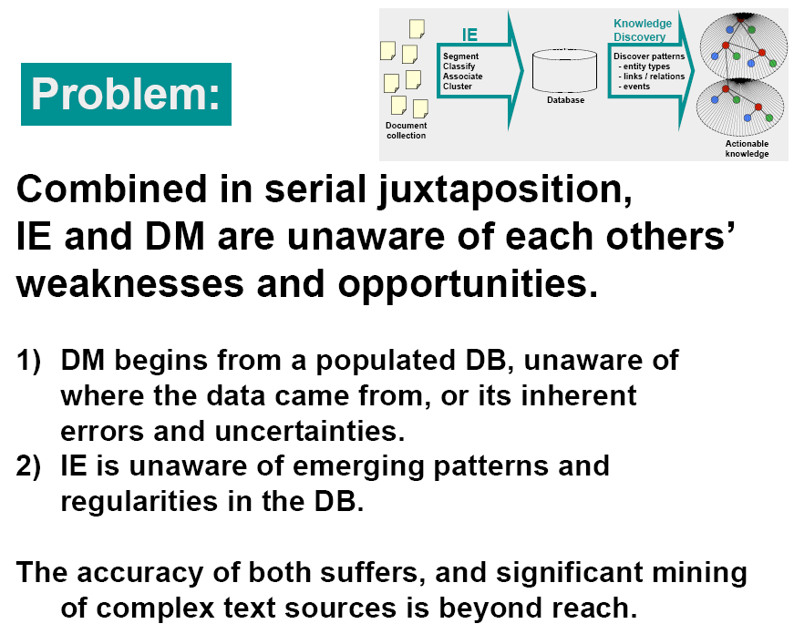
Source: Andrew McCallum, UMass Amherst

Slide 32
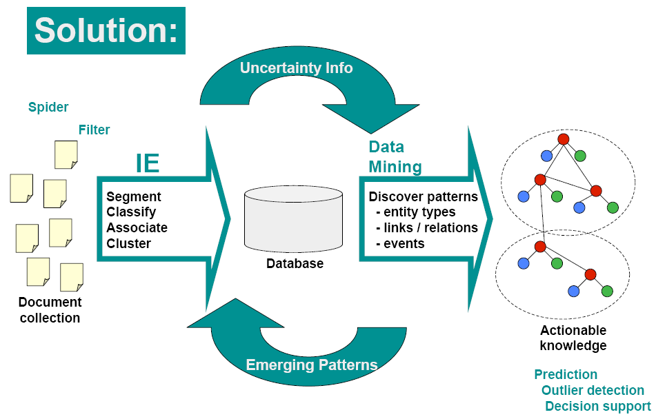
Source: Andrew McCallum, UMass Amherst

Slide 33
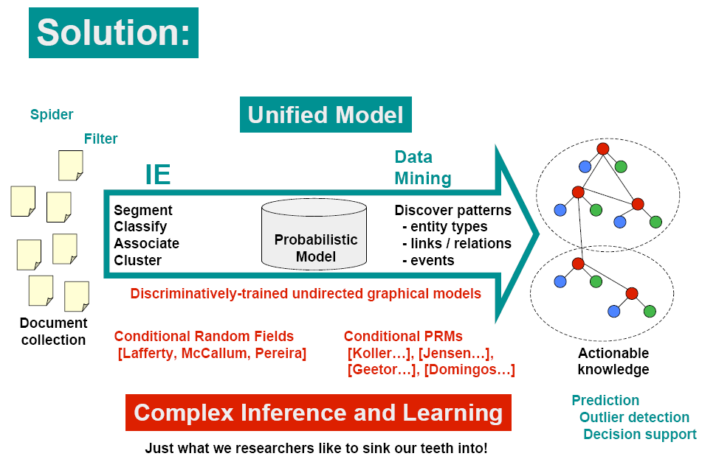
Source: Andrew McCallum, UMass Amherst

Slide 34
Research Questions
What model structures will capture salient dependencies?
Will joint inference actually improve accuracy?
How to do inference in these large graphical models?
How to do parameter estimation efficiently in these models, which are built from multiple large components?
How to do structure discovery in these models?
Source: Andrew McCallum, UMass Amherst

